Slide 1
A Predictive Analysis on Food Desert
DATAS6101 – Intro to Data Science Project
Abishek Chiffon, Keerthana Aravindhan, Mowzli Sre Mohan Dass, Robert Williams

Slide 2



Food Desert

Slide 3

Tract area
½ mile for Urban 10 mile for Rural
Tract area
1 mile for Urban 10 mile for Rural
Tract area
1 mile for Urban 20 mile for Rural

Slide 4









Variables Considered
INCOME
POVERTY
ACCESS
ETHNICITY
POPULATION
GROUP QUARTERS
AGE

Slide 5
Overview on the previous EDA
Geographic Distribution
Urban vs. Rural Classification
Correlation between the Poverty rate and food desert
Impact of Transportation and Vehicle Access
Group Quarters, Demographic Groups
Age and Population

Slide 6
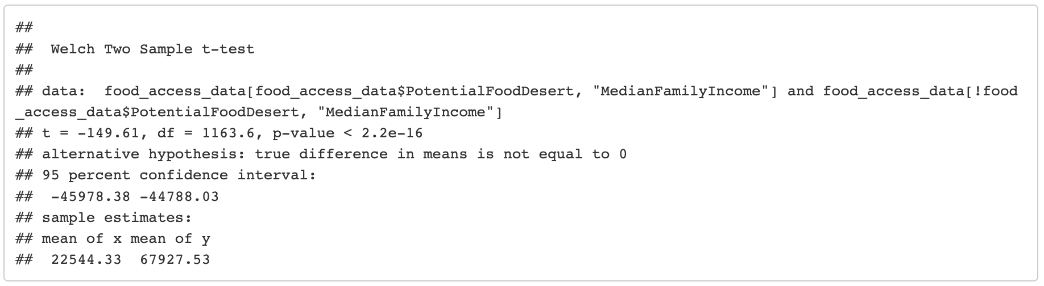
Impact of Median Family Income
Showed median family income has a significant impact on Food Desert
So conducting a Logistic Regression to get more insights

Slide 7
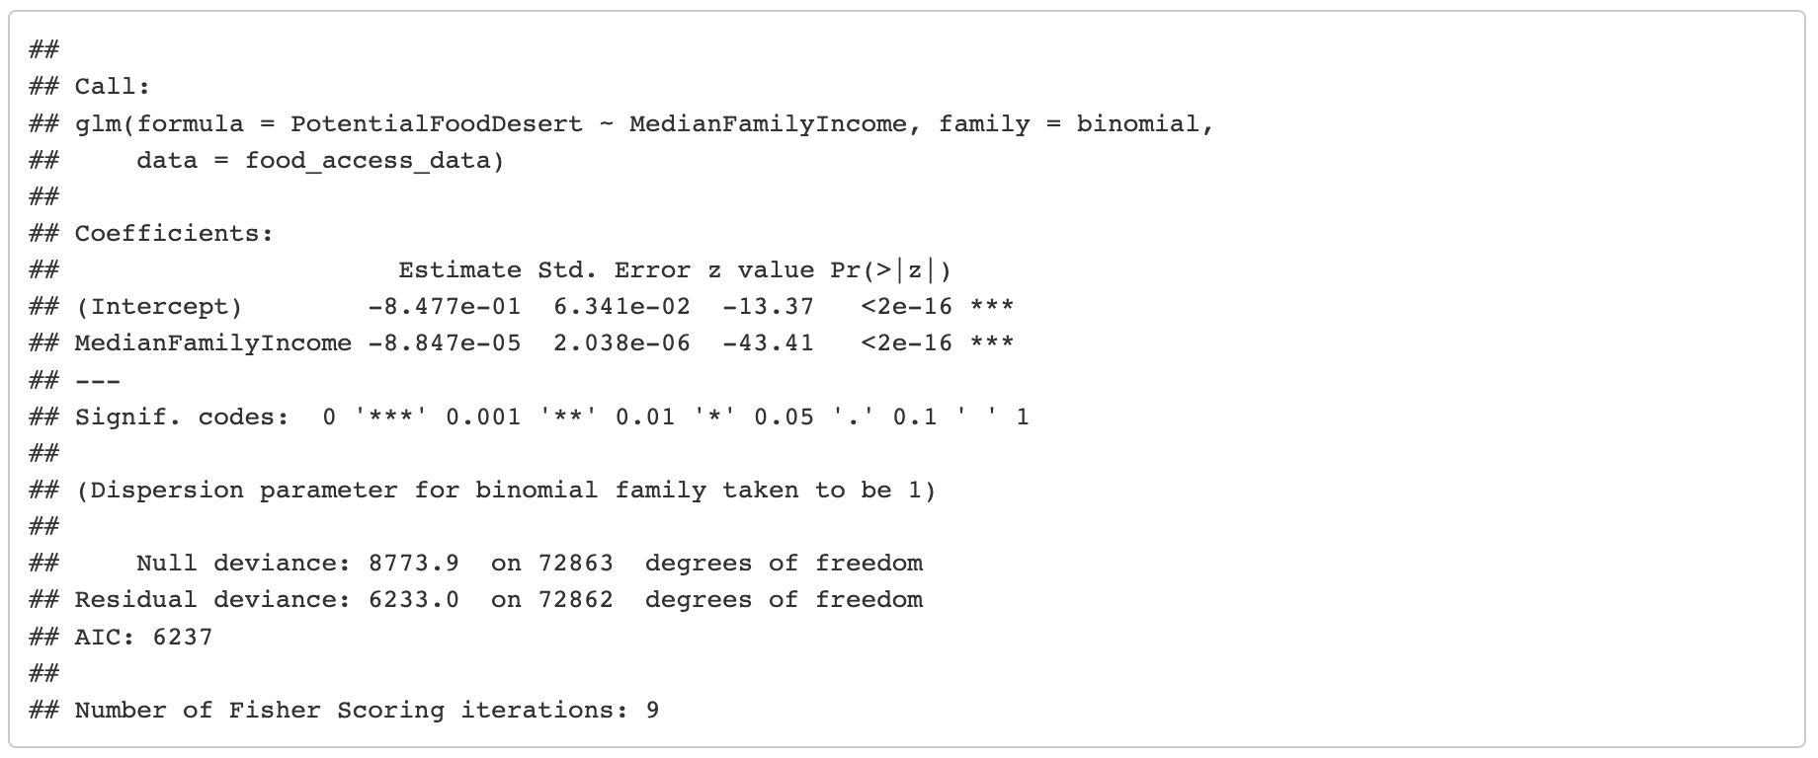
Impact of Median Family Income
The exponential coefficient shows very low impact
Has a negligible change in the odds of being a food desert

Slide 8
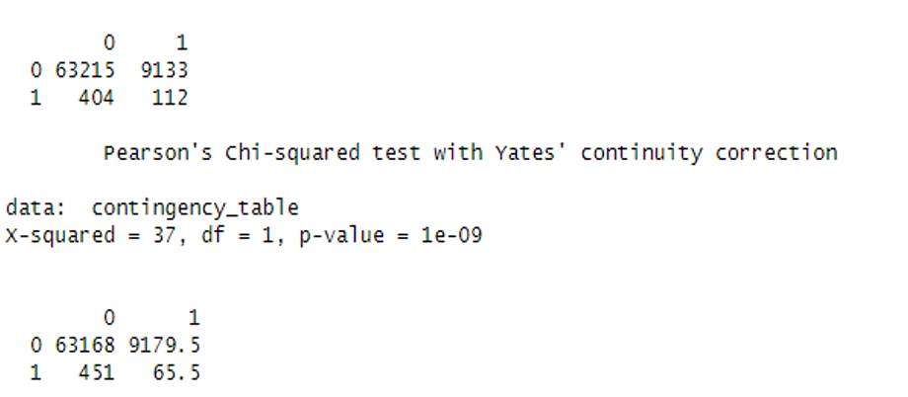
Correlation between GroupQuarters and prevalence of Food Desert
Chi-square (GOF) between GroupQuartersFlag and LILATracts_1And10:
Conclusion:
Low p-value - reject the null hypothesis
Thus there is a significant association or correlation between "GroupQuartersFlag" and "LILATracts_1And10."

Slide 9
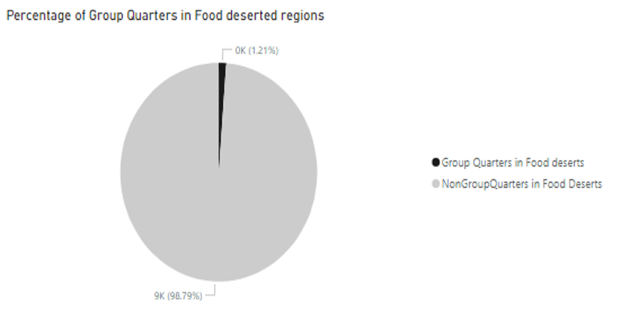
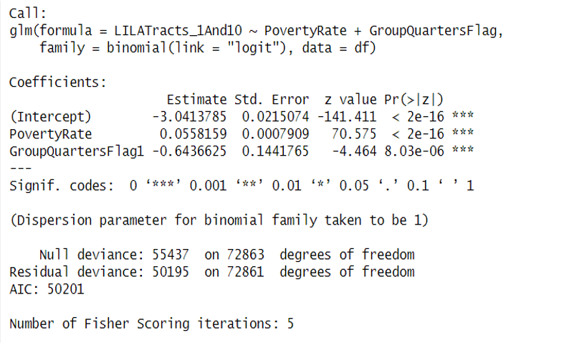
Impact of GroupQuarters on Food Desert
GroupQuartersFlag of 1 is associated with a decrease of 0.643663 in the log-odds of the response variable being 1
For a one-unit increase in GroupQuartersFlag1, the odds ratio decrease by a factor of approximately 0.5253647
GroupQuartersflag negatively affect the Food deserts likelihood

Slide 10
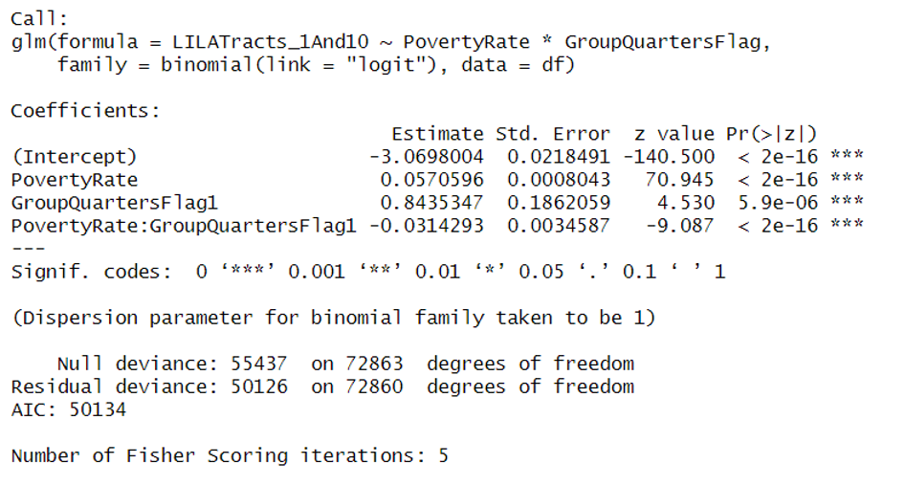
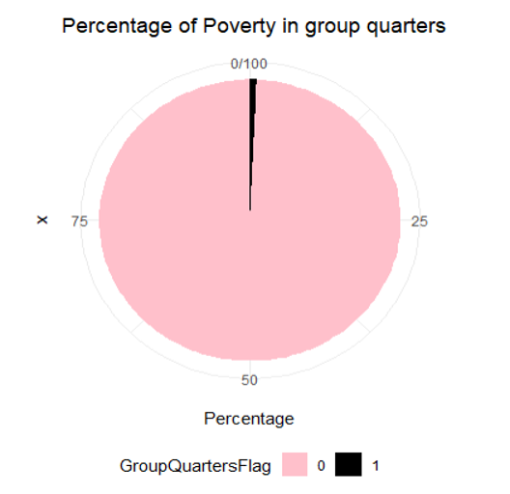
Impact of GroupQuarters and Poverty rate on Food Desert
In Non GroupQuarters (GroupQuartersFlag is 0), one unit increase in PovertyRate is associated with a relatively larger increase (0.0570596) in the log-odds of the response variable being 1.
In GroupQuarters (GroupQuartersFlag is 1), one unit increase in PovertyRate is associated with smaller increase (0.0256303) in the log-odds of the response variable being 1.

Slide 11
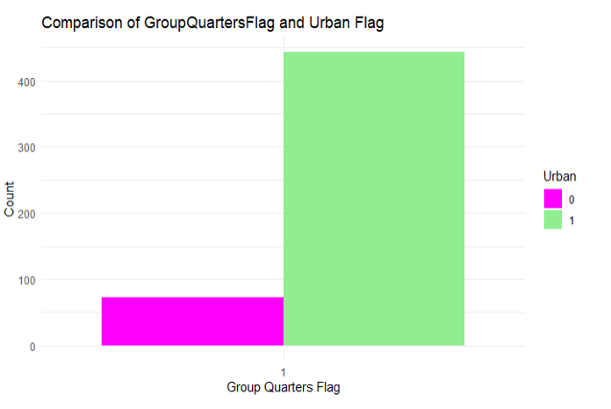
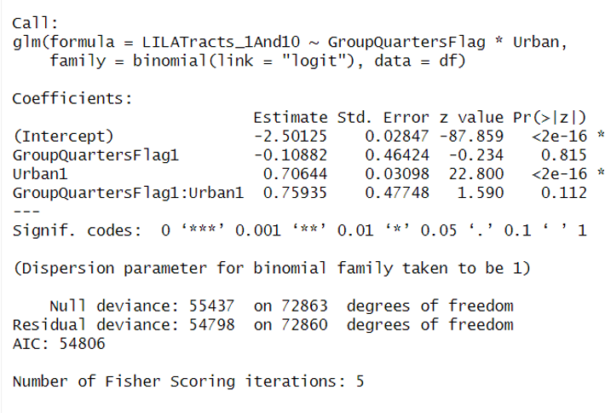
Impact of GroupQuarters and Urban on Food Desert
The positive coefficient (0.75935) suggests that the presence of group quarters has a stronger positive effect on the log-odds in Urban, but this effect is not statistically significant at the conventional levels

Slide 12
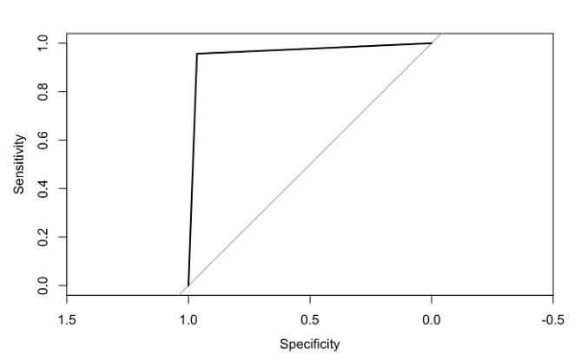
Prediction Models: Logistic Regression in LILA
AIC : 179138
AUC: 0.961
Only ∞ and 0 in the log odds
While some variables gives perfect separation
The perfect separation is caused because LILA is derived from LowIncomeTract
c("State",, “LowIncomeTract”, "County","Urban","GroupQuartersFlag","lahunv1share","PCTGQTRS","MedianFamilyIncome","lawhite1","lablack1","laasian1","lahisp1","lanhopi1","laomultir1","laaian1","lakids10","lakids1","TractKids","laseniors1","laseniors10","TractKids","TractSeniors","TractWhite","TractBlack","TractAsian","TractNHOPI","TractAIAN","TractOMultir","TractHispanic","TractHUNV","TractSNAP", "PovertyRate")

Slide 13
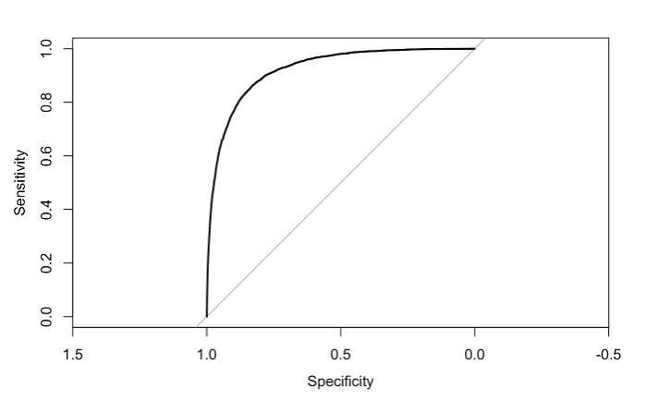

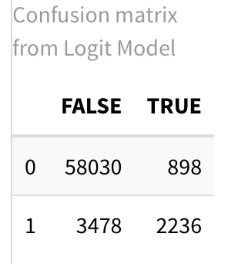
Prediction Models: Step-wise Logistic Regression on LILA
glm(formula = LILATracts_1And10 ~ lahunv1share + MedianFamilyIncome + Urban + laseniors10 + laomultir1 + TractHUNV + TractSNAP + TractHispanic + lakids1 + TractWhite + lablack1 + GroupQuartersFlag + PovertyRate + lahisp1 + TractAIAN + laseniors1 + TractSeniors + TractOMultir + TractKids + TractBlack + lakids10,
family = binomial(link = "logit"), data = cleaned_data)
Null deviance: 43179 on 67542 degrees of freedom
Residual deviance: 24885 on 67521 degrees of freedom
AIC: 24929

Slide 14
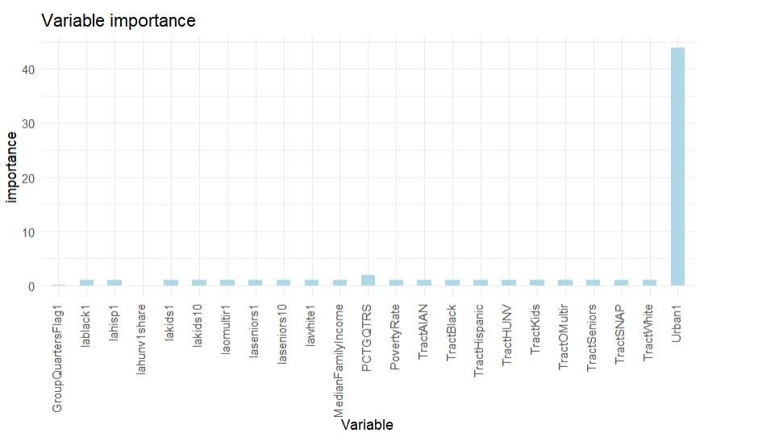
Log odds ratio of model predicting Food Desert

Slide 15
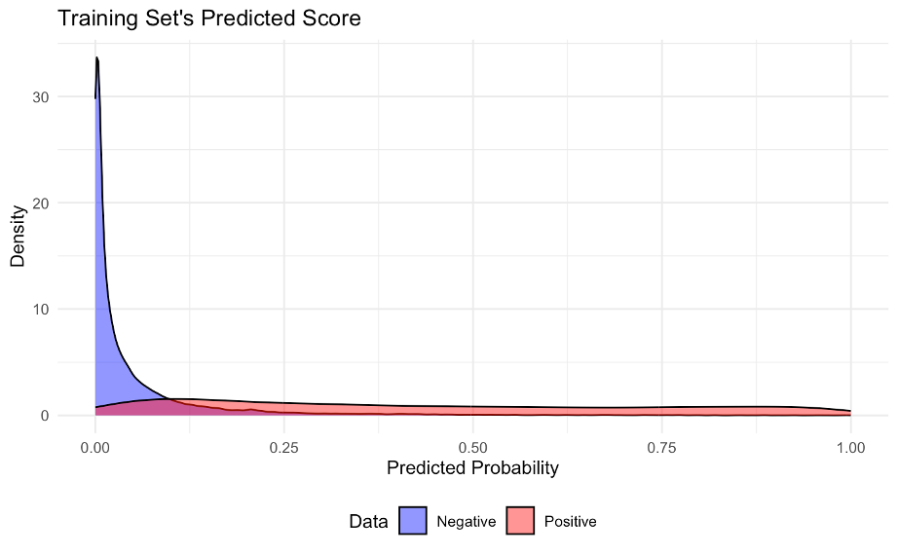
LILA Logistic : Training Set - Predicted Score
Younden’s Index
Cutoff : 0.08
0.30786 precision
0.87071 recall
0.82149 accuracy

Slide 16
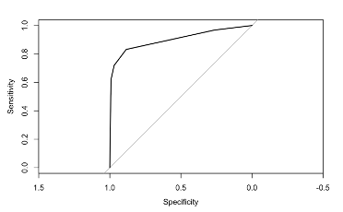
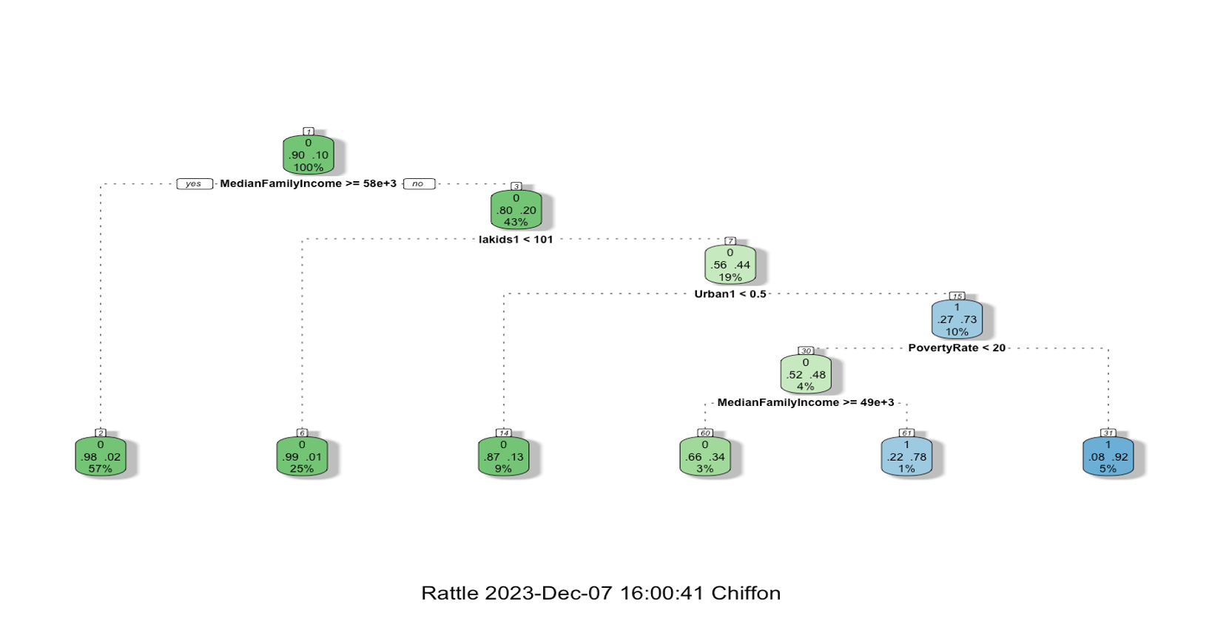
LILA CART
AUC: 0.901

Slide 17
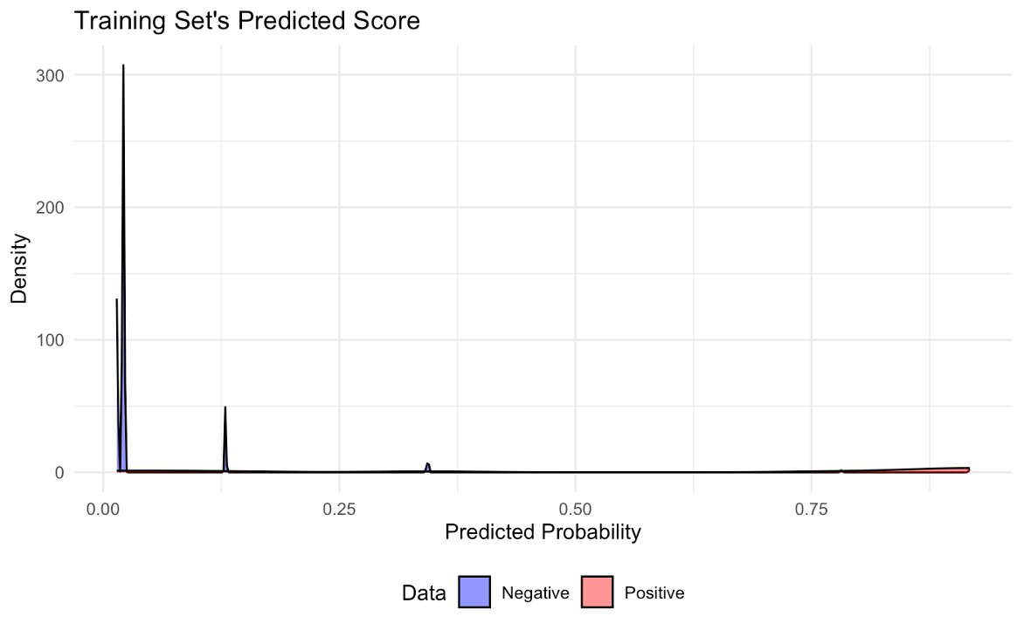
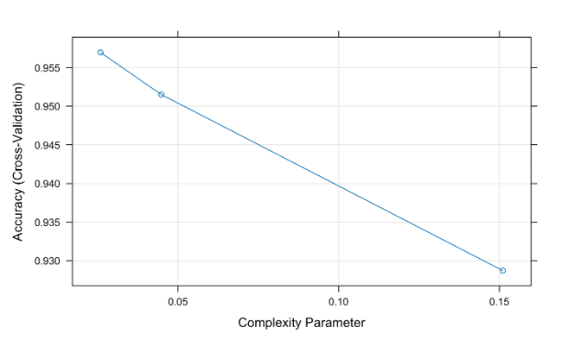
LILA Cart Training Set - Predicted Score
Younden’s Index
Best cut-off : 0.07
Precision : 0.43029
Recall : 0.83996
Accuracy : 0.89117

Slide 18
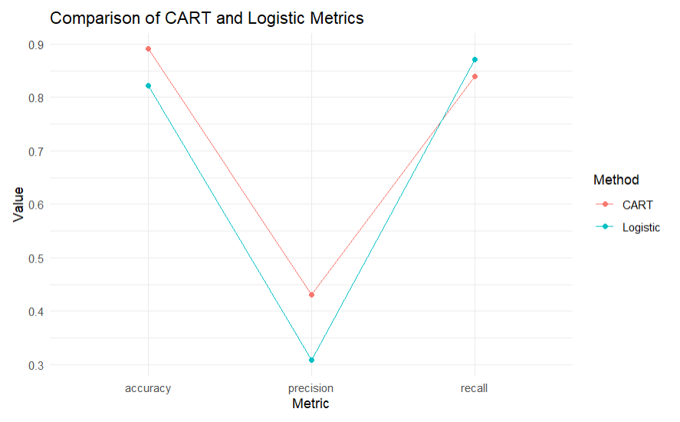
Comparison of CART and Logistic Metrics

Slide 19
POVERTY RATE ANALYSIS

Slide 20
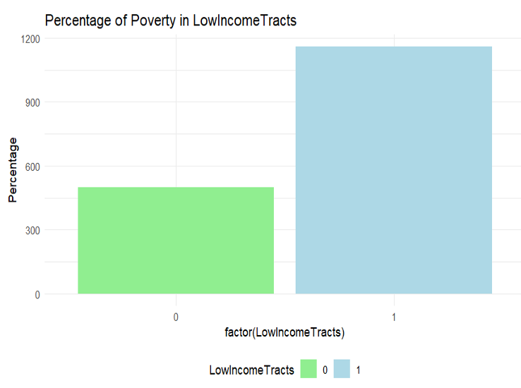
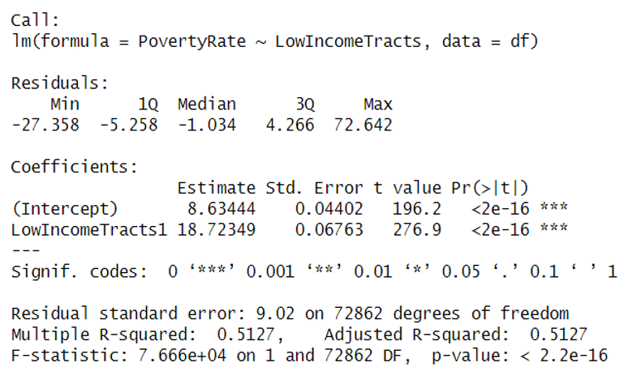
Impact of LowIncomeTracts on Poverty Rate
The presence of low-income tracts is associated with an increase of 18.72349 unit in the predicted poverty rate compared to areas without low-income tracts.

Slide 21
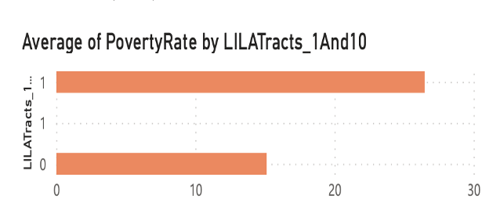
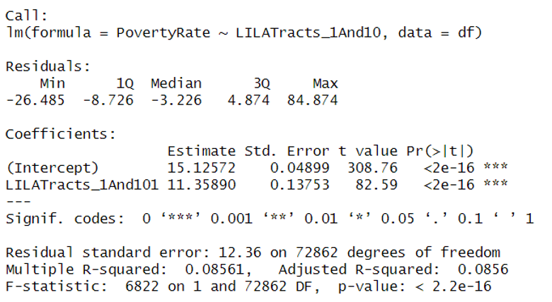
Impact on Food Desert on Poverty
On average, the presence of Food desert is associated with an increase of 11.35890 units in the predicted poverty rate compared to areas without such tracts.

Slide 22
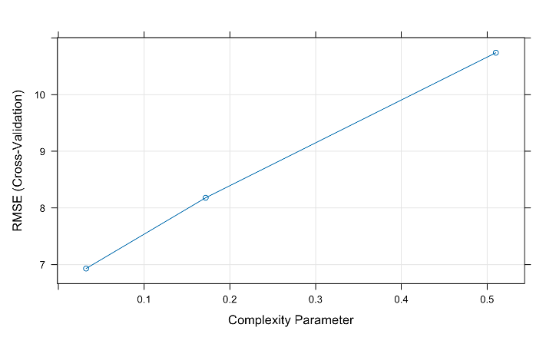
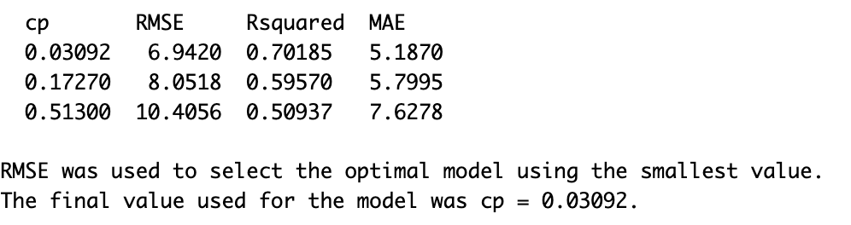
Poverty Rate - CART cross validation

Slide 23
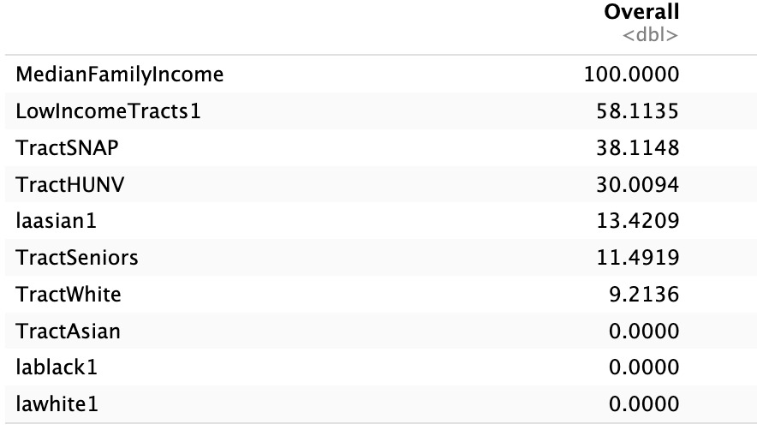
Variable importance of predicting Poverty Rate

Slide 24
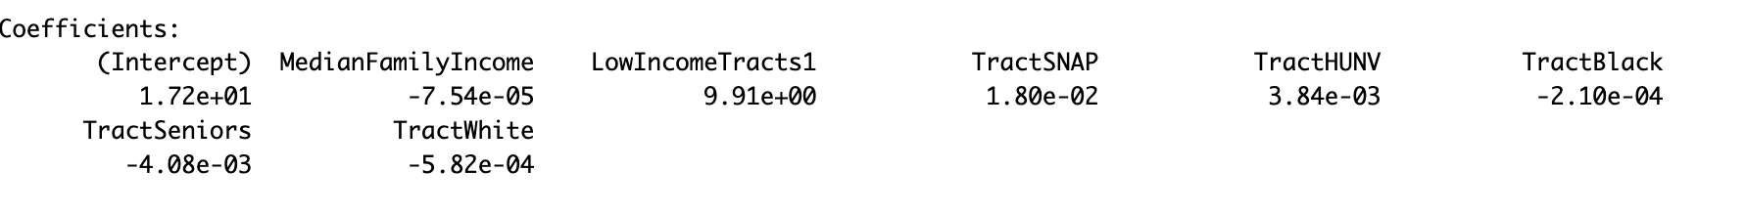
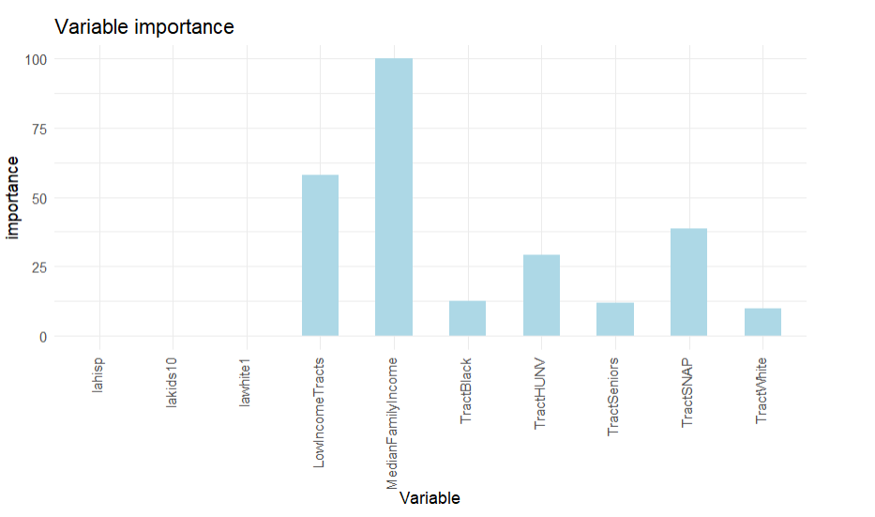
Linear Regression
Variable Importance from Linear Regression
R2 : 0.63682
RMSE : 7.4614

Slide 25
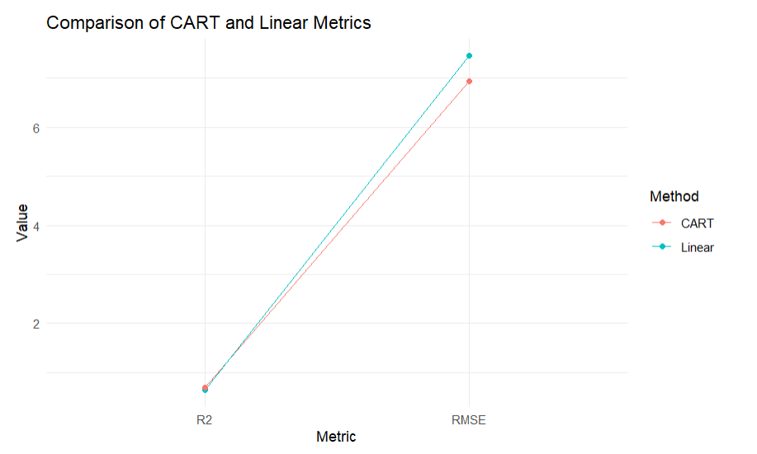

Slide 26
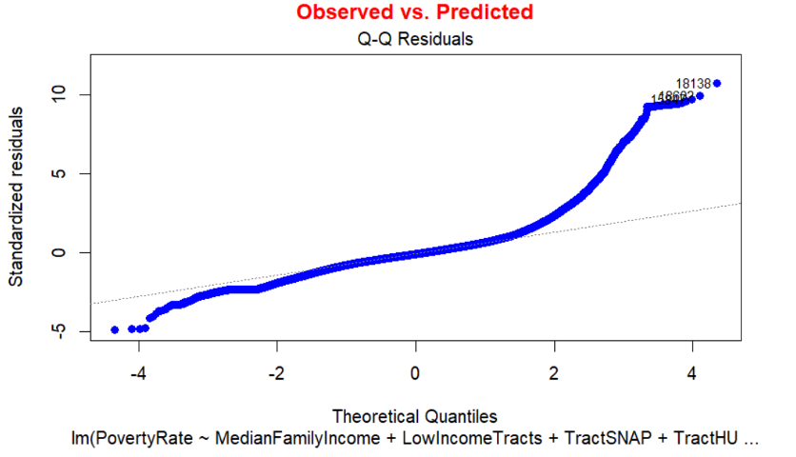
Linearity, Outliers and Influential Points

Slide 27
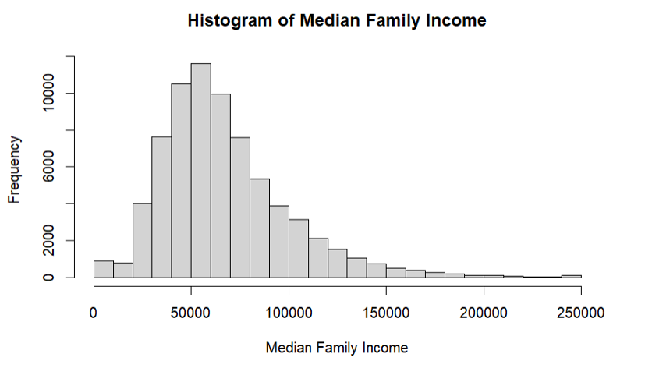
Normality of Median Family Income

Slide 28
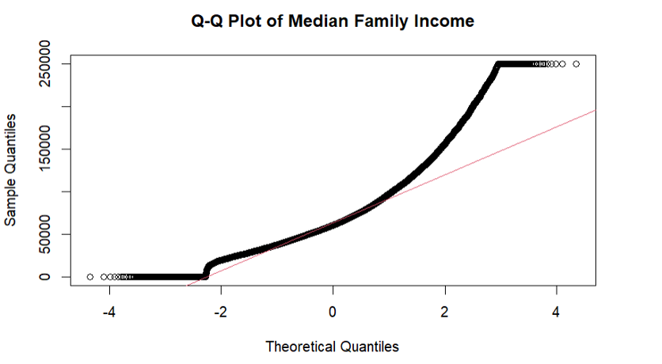
Normality of Median Family Income

Slide 29
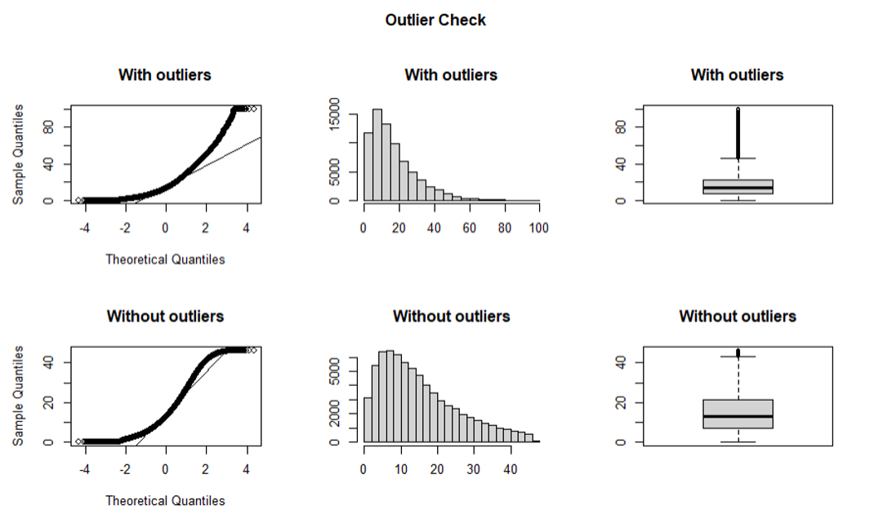
Normality of Poverty Rate

Slide 30
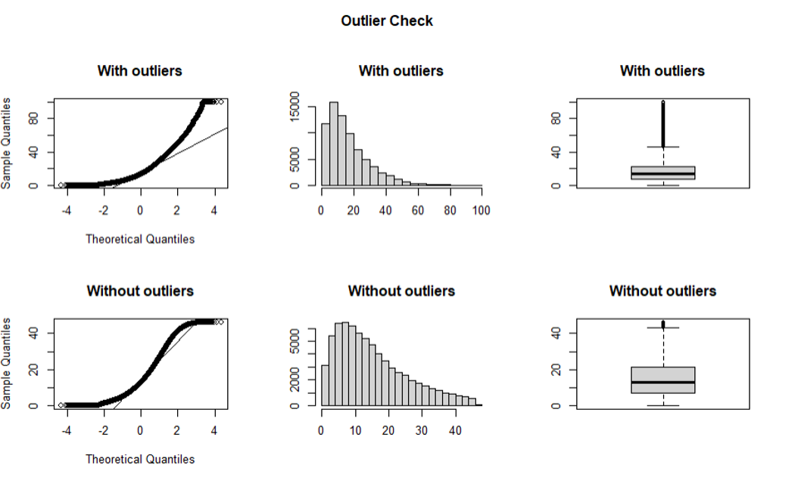
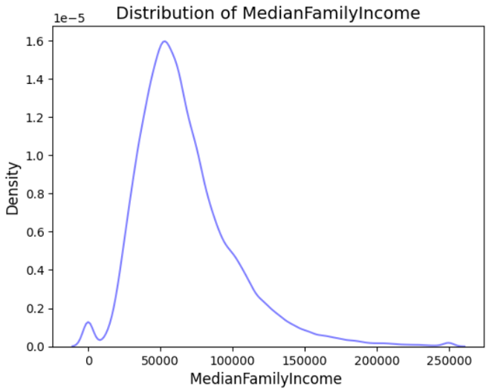
Normality of Median Family Income

Slide 31
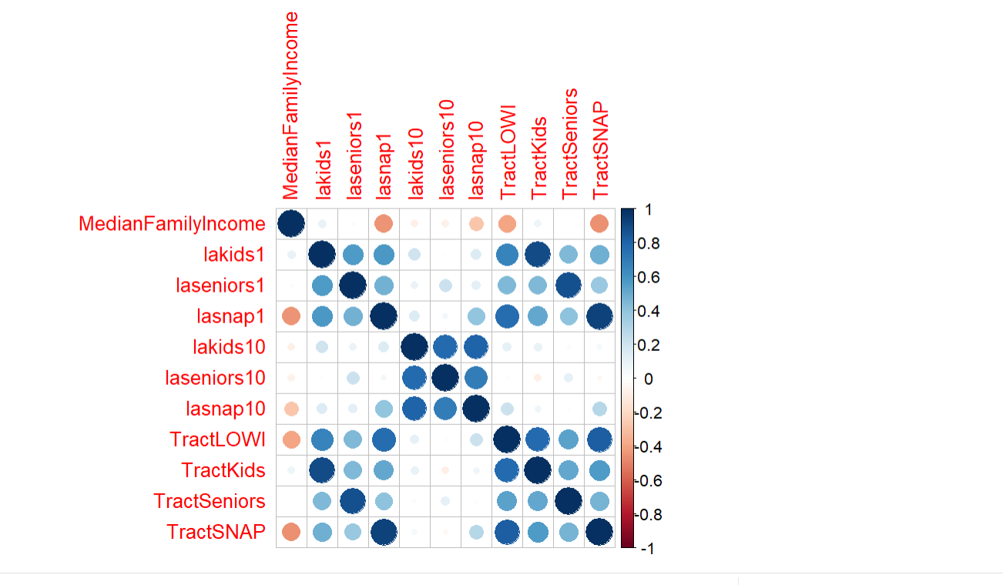
Can a certain level of income contributes to a Food Insecurity/Desert in a given area?
Notes:
I started with identifying what variables may contribute to a certain income level for food desert in a given area via correlation analysis.

Slide 32
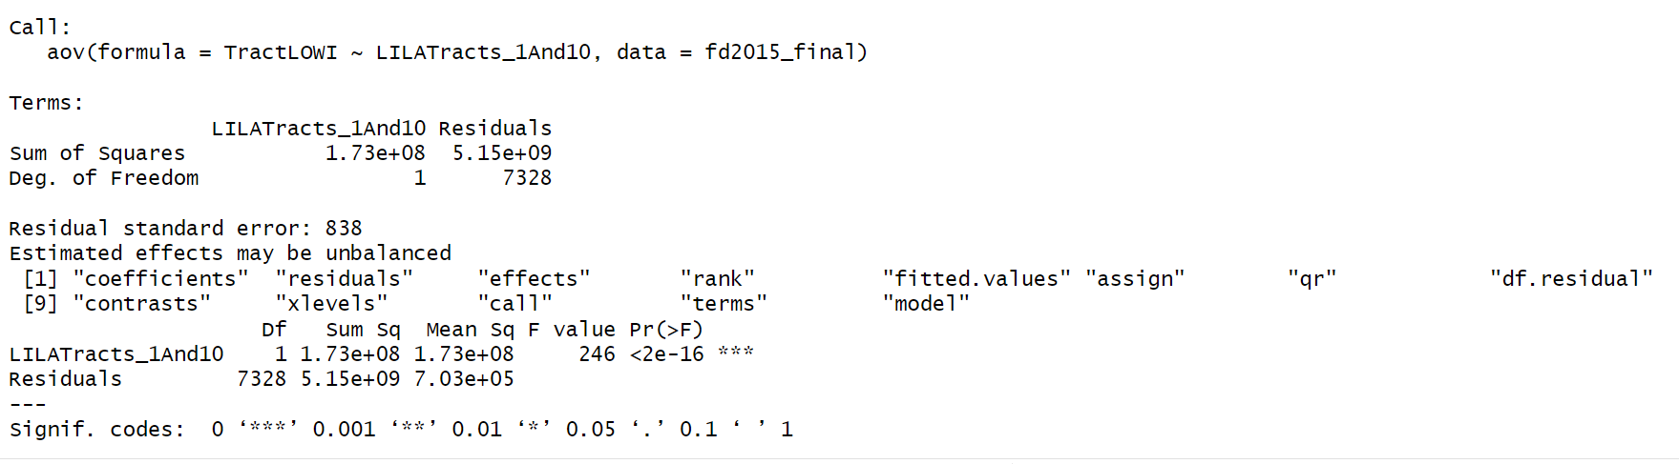
Can a certain level of income contributes to a Food Insecurity/Desert in a given area?
Notes:
Then, I used the Total Low lncome population with Low Income Low Access at 1 mile and 10 miles population in an ANOVA analysis to see if there would be a major differences with income level for an area.

Slide 33
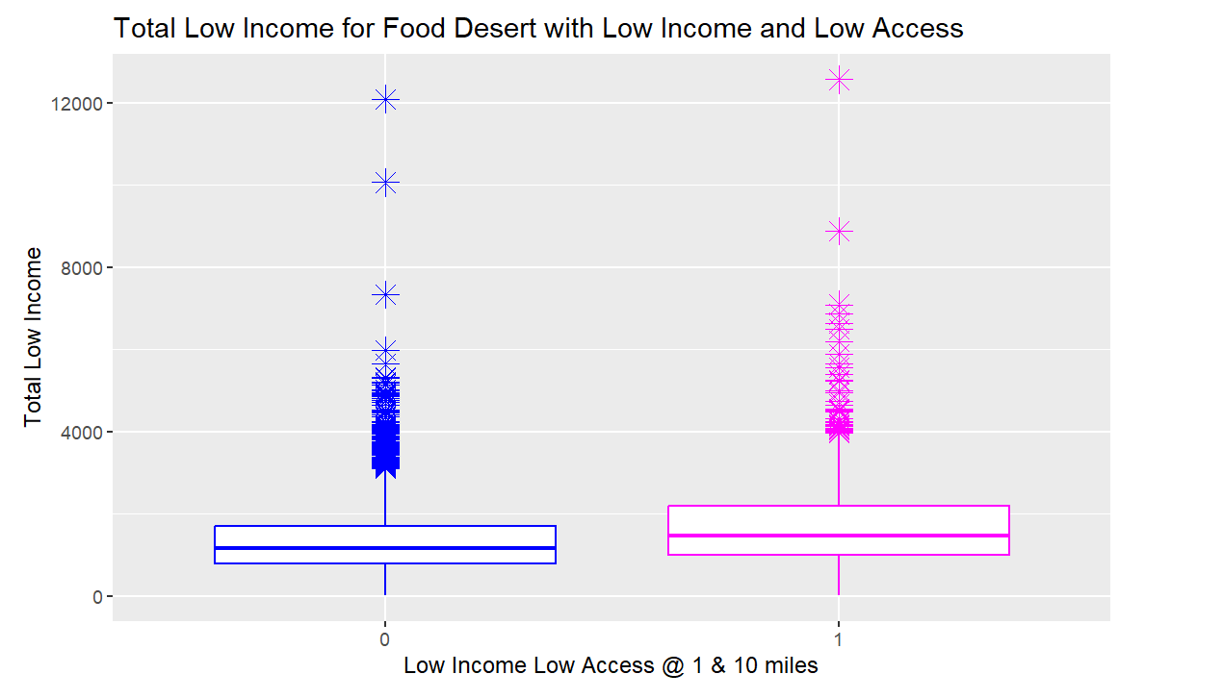
Can a certain level of income contributes to a Food Insecurity/Desert in a given area?
Notes:
And it appears that the Total Low Income population versed the Low Income and Low Access at 1 mile and 10 miles population had very little differences on the income level for a given food desert.

Slide 34
Thank You

